Slide 1
"Interactive Analysis of IPL Team Performance, Achievements, and Market Value"
NALIN KUMAR V
16:09:2024

Slide 2
Aim of the Project:
Objective: The primary objective of this project is to develop a tool that provides comprehensive statistics and insights about IPL teams.
The aim is to facilitate a better understanding of team performance, market value, and fan engagement through data analysis.
Aims: To present detailed statistics for various IPL teams.
To offer insights into team performance metrics such as win percentages and championships.
To display follower counts and market values for a comparative analysis.
To provide an interactive and user-friendly interface for querying team data.

Slide 3
Problem Statement:
Managing and Analyzing sports team statistics can be challenging due to the large volume of data and the need for real-time updates.
IPL fans, analysts, and stakeholders require a system that consolidates and presents team statistics efficiently.
Challenge Overview:
Data Overload: Handling and interpreting a vast array of team statistics from various sources. -
Lack of Integration: Difficulty in accessing consolidated and comparative team data from a single platform.
Real-Time Updates: Need for up-to-date statistics to reflect recent matches and changes.

Slide 4
Project Description:
Overview: The IPL Team Statistics Analysis Tool is designed to provide a comprehensive view of IPL team performance and market dynamics. It integrates team statistics such as wins, finals appearances, championships, and fan engagement metrics.- Scope and Objectives:
Scope: The project covers data retrieval, display, and user interaction for IPL team statistics.
Objectives: To build a tool that aggregates IPL team data, provides detailed statistics, and supports user queries.
Technologies and Methodologies:
Technologies: Python (for data handling).
Methodologies : Data aggregation and presentation using Python dictionaries and error handling for robust user experience.

Slide 5
Functionalities:
Main Functionalities:
Team Data Retrieval : Access detailed statistics for each IPL team, including win percentages and championships.
User Query Handling: Allow users to query data by team name and display relevant statistics.
Error Handling: Gracefully manage cases where the user inputs an invalid team name.
Data Representation: Show statistics such as followers and market values for comparative analysis.
Interactive Display : Present data in a user-friendly format with clear labels and descriptions.

Slide 6
Functionalities :
Additional Functionalities:
Input Normalization : Convert user inputs to uppercase to match the dictionary keys.
Error Logging: Log and handle errors to ensure smooth operation and user guidance. Code Examples: Demonstrate key algorithms and data structures used in the project. Output Customization : Provide customized messages and reports based on user queries.

Slide 7
Input Versatility with Error Handling and Exception Handling:
Input Versatility : The tool accepts various user inputs for team names, handling different formats and cases.
Normalization: Converts user input to uppercase to match the dictionary keys.
Error and Exception Handling:
Validation: Checks if the input team name exists in the dictionary.
Exception Handling: Captures and reports errors such as invalid team names or unexpected inputs.
Example Scenario:If a user enters a team name that is not in the IPL dictionary, the system provides an error message and prompts for a valid team name.

Slide 8
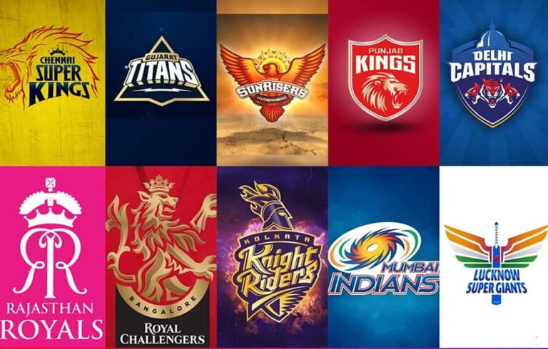
The report highlights the league's global appeal, strategic initiatives, and engagement with fans. The value of IPL as a business grew by 6.5 per cent to $16.4 billion (₹1,35,000 crore in 2024)

Slide 9
Code Implementation:
Implementation Insights:
Key Algorithms: The main algorithm handles user queries and retrieves data from the IPL dictionary.
Data Structures: Utilizes a dictionary to store and manage IPL team data.
Code Organization: The code is structured to handle user input, validate data, and display results.
Code Snippets: python
# Example of retrieving team data
def get_team_info (team _ name):
team_name = TEAM NAME
try:
return IPL[team_name]
except KeyError:
return "Team not found"

Slide 11
Results and Outcomes:
Results Achieved:
Effective Data Retrieval: Successfully retrieves and displays detailed statistics for IPL teams.
User Interaction: Provides a responsive interface for querying team information.
Error Management : Handles invalid inputs gracefully and provides user-friendly messages.
Visual Representations:
Statistics : Comparison of win percentages and market values among teams.
Charts: Display data trends and team performance visually.

Slide 12
Conclusion:
Summary: The IPL Team Statistics Analysis Tool efficiently consolidates and presents IPL team data, offering valuable insights into team performance and market dynamics. The project enhances data accessibility and user interaction.
Future Developments:
Enhanced User Interface : Develop a graphical user interface (GUI) for better user experience.
Integration with Live Data: Implement real-time data updates and live statistics.

